Slide 1
Front End Engineering-I Project
GOOGLE SEARCH ENGINE LOOKALIKE
Team Details:
Kanushi Gupta(2210991743)
Kaniska Maity(2210991741)
Kannan Rooprai(2210991742)
Kapil(2210991744)
Faculty Coordinator: Mr.Anil Dhawan
:
Chitkara University Institute of Engineering and Technology,
Chitkara University, Punjab

Slide 2
Table of Contents
Introduction
Problem Statement
Technical Details
Key Features
Project Highlights
Conclusion

Slide 3
Introduction
Title: Google Search Engine Lookalike
Project Description: A website designed to resemble the look and functionality of the Google search engine is known as a Google search engine look-alike. The search capabilities and features of this website are comparable to those of the original Google search engine.
The interface and functionality of this Google search engine lookalike are very similar to those of the original. The layout and features are nearly identical to those of the original Google search engine.

Slide 4
Problem Statement
Why Use a Google Search Engine Lookalike?
A Google-like search engine could be used for a number of different reasons. One explanation is security concerns. Certain individuals may not maintain that Google should follow their ventures or gather their own information.
Another reason is that some lookalikes of Google provide exclusive features that Google does not. Some search engines, for instance, let users customize their search results or exclude particular kinds of content.

Slide 5
Technical Details
Using HTML,CSS and javascript you would need to use a number of technologies and approaches to create a Google-like search engine, such as:
HTML: Every website, including Google, is built on top of Hypertext Markup Language. Using HTML tags, you would need to construct the page's structure.
CSS: Flowing Templates are utilized to style the HTML content. Your Google search engine would get its colors, fonts, and layout from CSS.
Javascript: It is a high level language used to run the codes in html.
Design that responds: The Google search engine is responsive, which means that it works with a variety of screen sizes. You would have to involve media questions in CSS to make a responsive plan that changes with various gadgets.

Slide 6
Flexbox: Flexbox is a CSS layout module that makes creating responsive and flexible layouts simpler. It would be used to align page elements like the search bar and buttons
Fonts from Google: Google Textual styles is a library of free web text styles that you can use to style your text. To use the same fonts as Google, you can include Google Fonts in your HTML and CSS..

Slide 7
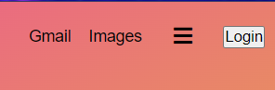


Key Features of the project
These buttons lead to other pages when clicked
On clicking ‘Happy Birthday!’ the entire page shows an animation
These icons lead to other pages as well as zoom in when the cursor in placed on them

Slide 8
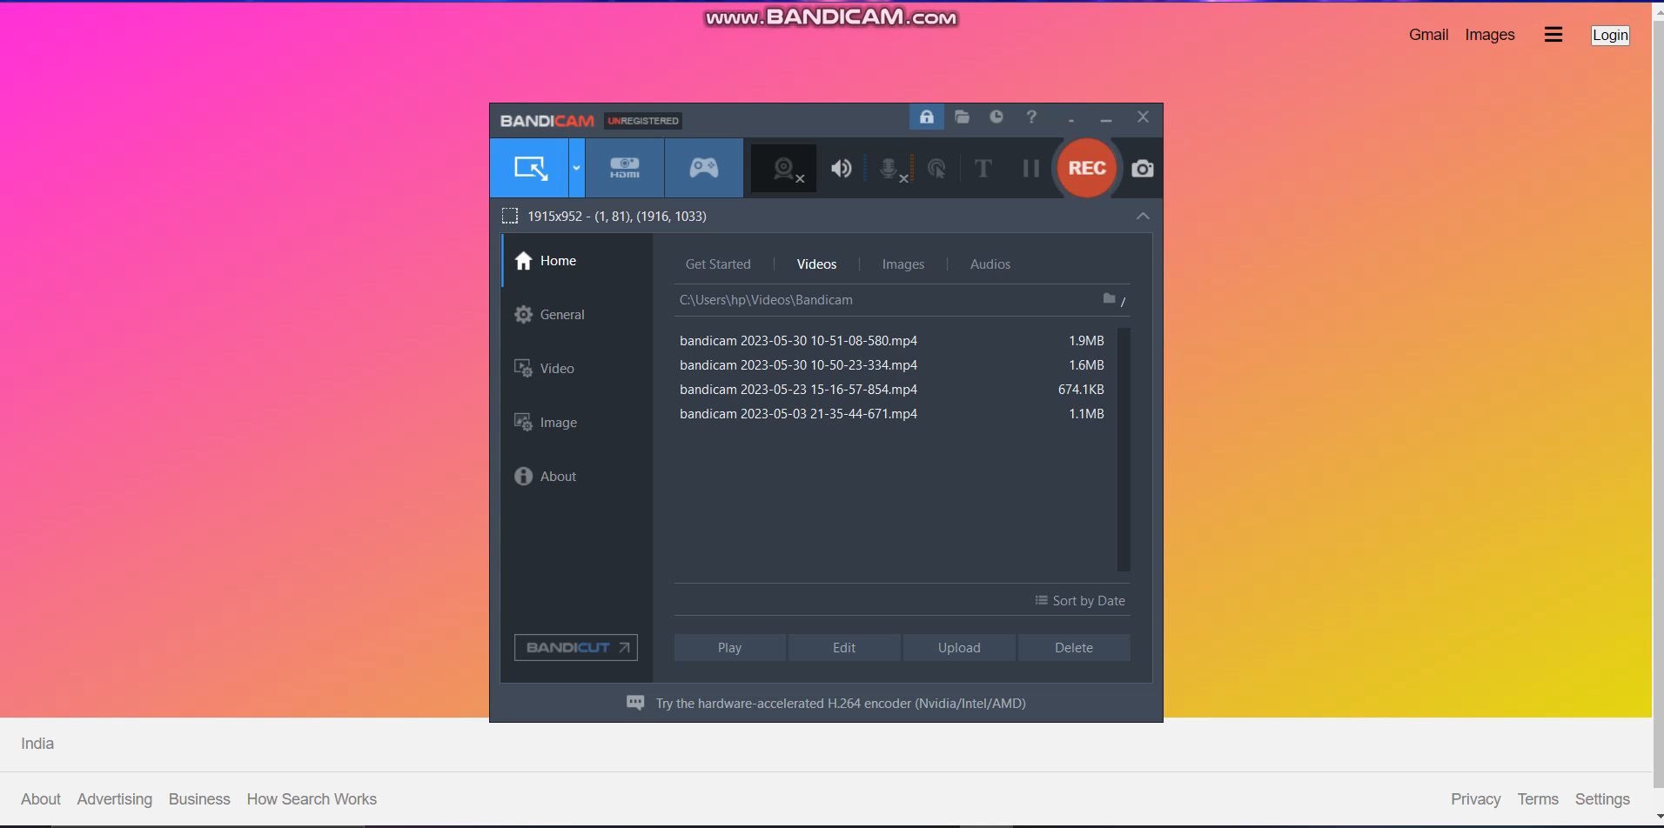
Working model of the Google Search Engine Lookalike

Slide 9
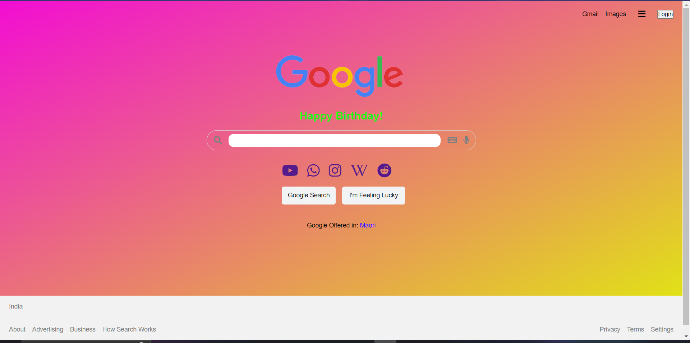
Project snippet
Snippet of how our google search engine lookalike looks!!

Slide 10
Conclusion
In conclusion, Google Search Engine has become the go-to search engine for many people around the world due to its accuracy ,relevance, and privacy features. With constant updates and new features, Google continues to improve its search engine to provide the best possible search experience for its users.
Team Experience:
It was a great team effort. We worked collaboratively , assigning different roles and responsibilities such as designing the layout, styling the page. We learned about Html and css fundamentals, trouble shooting and problem solving skills.. We would like to thank our Mentor to give us this project. Overall, this project provided us with practical experience and knowledge that we can apply to future projects.

Slide 11


